Slide 1
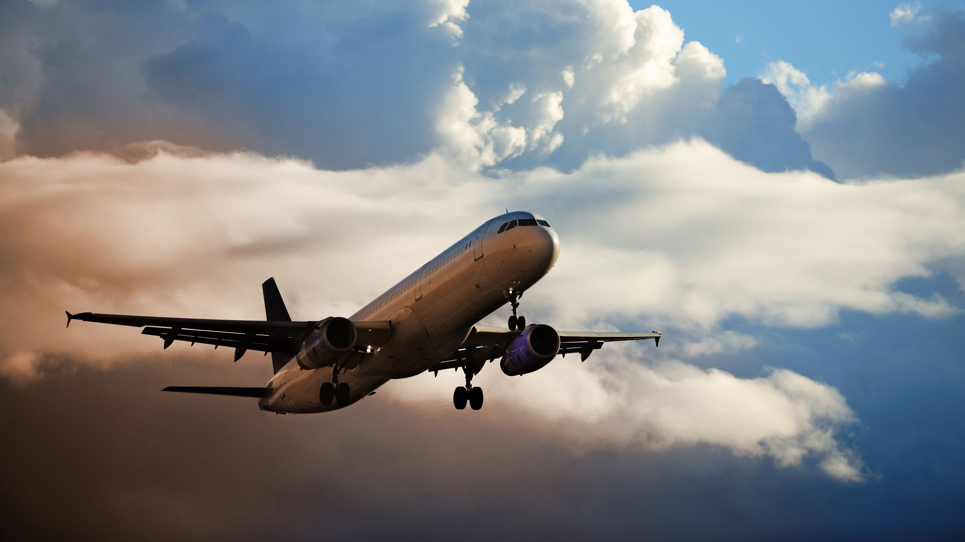
Airline Safety Executive Summary
Prepared by Santosh Omprakash

Slide 2
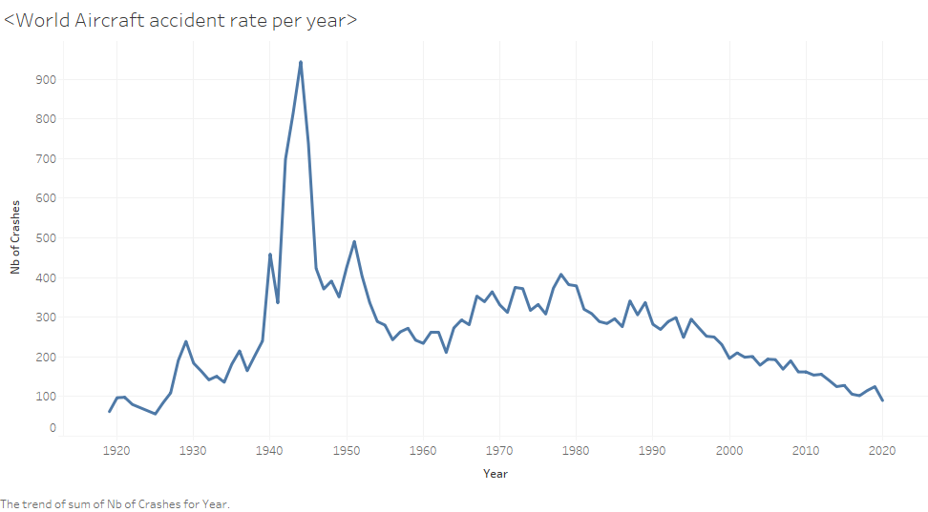
The general understanding of Airline Safety can be determined by evaluating the number of accidents reported till now From 2009 to 2019, the crashed have reduced by 50%

Slide 3
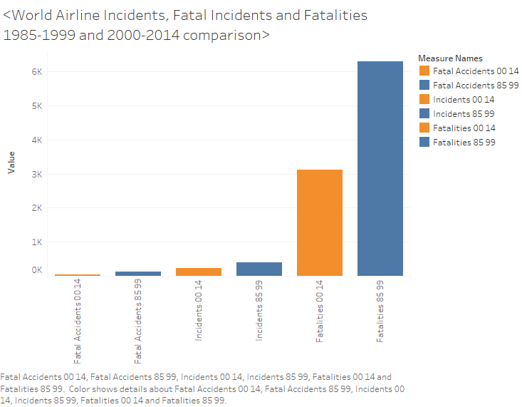
The Fatalities 2000-2014 is reduced by 50%
Although Fatalities are more, the number of Fatal Accidents contributing to it very less

Slide 4
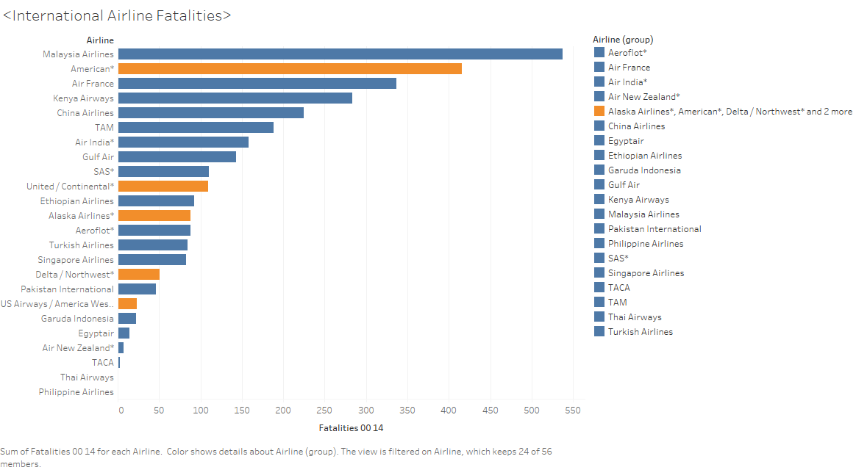
When compared to international Airline Fatalities, US Airlines counts are less
The reason for negative propaganda by Media could be due the data collected by them could be all international data

Slide 5
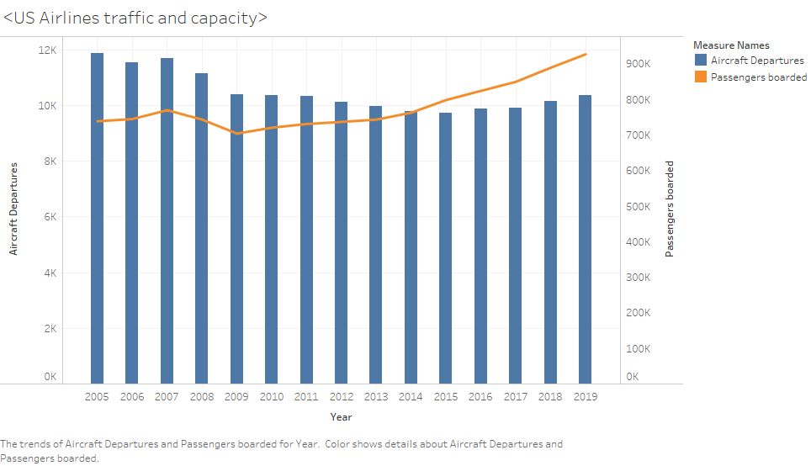
The number of Passengers boarded took a slight dip in 2009 which could be due to recession
Passengers boarded increased in 2015 even though the Aircraft departures slightly decreased
Passengers boarded has been increasing since 2009

Slide 6
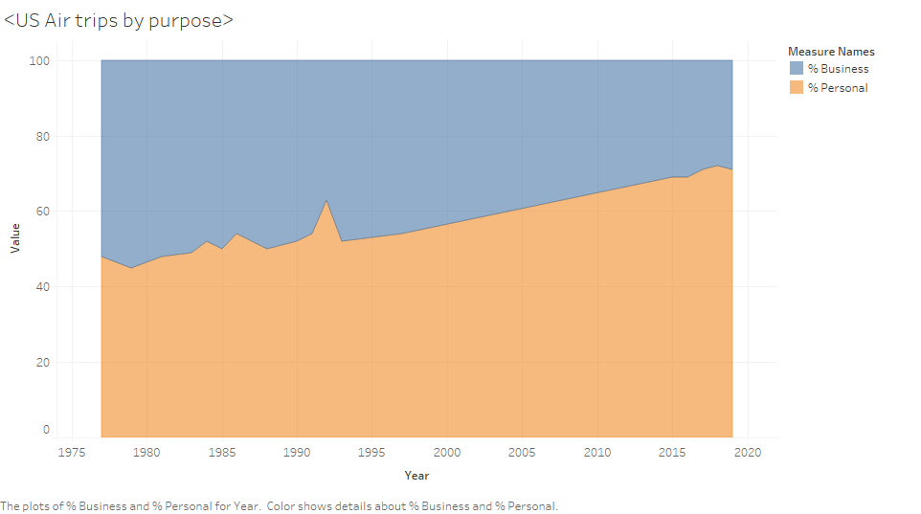
The percentage of passengers using Air Trips has been more for personal travel in recent years
Air travel is affordable and preferred by people over the years

Slide 7
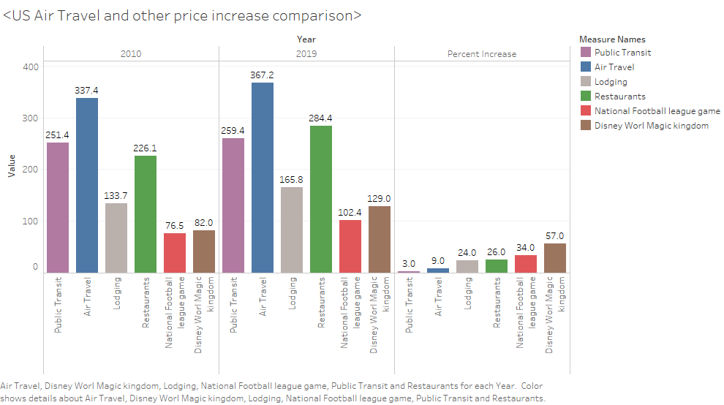
Although number of passengers has increased in Airlines, the cost of Air Travel has not seen much of increase when compared to previous decade
The Air Travel price increase is second only to Public Transit in this case

